Slide 1

LLM Reasoning Evaluation & Targeted Fine-Tuning Pipeline
“AI/ML Virtual Internship” at “AICTE-EduSkills Cohort-14”
Submitted by ,
Yash Kailas Doke [T400310722]
Under the Guidance of
Dr. B. D. Phulpagar
Department of Computer Engineering
PES Modern College of Engineering Savitribai Phule Pune University
25-April-2026
LLM Reasoning Pipeline

Slide 2
Outline
Internship Completion Certificate
Introduction
Problem Statement
Scope
Objectives
System Architecture
Methodology/ Algorithm
Technology Used
Weekly Work Details
Expected Results
Conclusion
Acknowledgement
List of references
LLM Reasoning Pipeline

Slide 3

Internship Completion Certificate
LLM Reasoning Pipeline

Slide 4
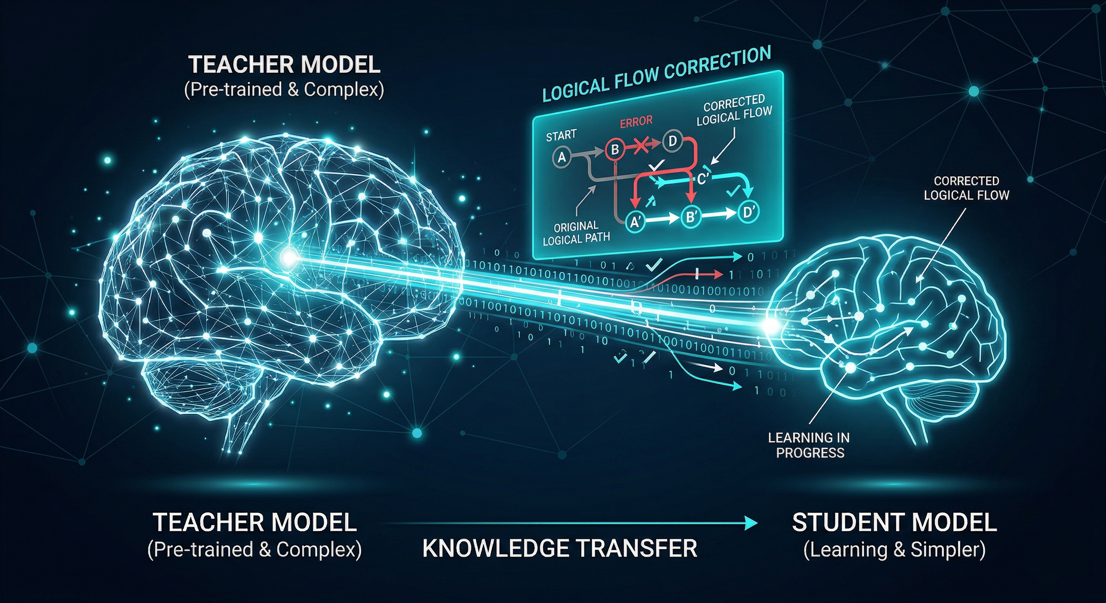
Introduction
The Reasoning Gap: AI chatbots (Qwen, Llama) are fluent but frequently make “Invisible Errors” in logic.
The Use-Case Needs: Medical, Navigation or Technical chatbots require domain-specialized reasoning, not just generalized word prediction.
Why Fine-Tuning Matters: General models are too large/expensive for local deployment; specialized small models (3B/7B) are the industrial preference for privacy and cost.
Our Solution: A two-phase “Diagnose-and-Fix” pipeline.
The “Teacher-Student” Strategy: A 14B model teaching a 3B model.
LLM Reasoning Pipeline

Slide 5
Problem Statement
Black-Box Scrutiny: Benchmarks (GSM8K, MMLU) only check “Did the model get the right answer?” (Blind Scoring). Binary scoring hides logical drift and intermediate factual hallucinations.
Error Propagation: Hidden failures in early steps cascade into wrong conclusions. A single faulty assumption in “Step 2” makes subsequent correct steps meaningless.
Feedback Deficiency: Traditional broad-data fine-tuning doesn’t target specific skill gaps. Practitioners lack the diagnostics to repair individual logic (e.g., Arithmetic vs. Tool-use).
Research Goal: Shift from measuring “what” the final answer is to analyzing “where” the model failed.
LLM Reasoning Pipeline

Slide 6
Scope & Objectives
Scope:
Unified Vision: Building a platform to verify and fix “logical drift” in localized LLMs.
Targeted Reasoning Categories: Arithmetic (GSM8K), Causal Reasoning (CRASS), Tool-Use Planning, and Factual Consistency.
Objectives:
Build a meta-evaluation pipeline to pinpoint reasoning failures.
Use diagnosis data to generate Targeted Training Traces.
Execute LoRA to drastically reduce step-level failure rates.
Using FP16 precision LoRA to teach a 3B parameter “Student” model the logic of a 14B “Teacher.”
LLM Reasoning Pipeline

Slide 7
System Architecture
Phase 1 — Diagnose (The Teacher):
Task Decomposer: Breaks CoT into atomic, numbered logical steps.
Step Evaluator (Teacher): High-parameter model (14B) scores every step.
Divergence Logic: Identifying where logic drifts using Ground-Truth Backtracking.
Phase 2 — Fix (The Learning Loop):
Dataset Builder: Failure reports are converted into expert-corrected training traces.
Fine-Tuning Engine: LoRA-based targeted weight updates with FP16 high-precision.
LLM Reasoning Pipeline

Slide 8
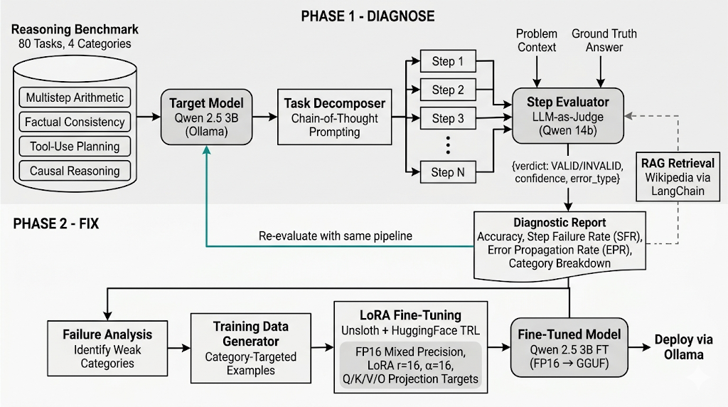
System Architecture
Fig 1: Architecture Diagram
LLM Reasoning Pipeline

Slide 9
Methodology/Algorithm
Diagnosis:
Load dataset -> Decomposition -> LLM-as-Judge scoring.
Categorize failure type (Hallucination vs. Logic Drift).
Fine-Tuning:
Identify weakest logical category from Phase 1.
Generate high-quality “Correct Trace” training examples.
Execute LoRA Fine-Tuning with FP16 precision (rank=16, 3 epochs).
Merge & Quantize to GGUF for efficient local inference via Ollama.
LLM Reasoning Pipeline

Slide 10
Technologies Used
Inference Platforms: Ollama (Local) & Groq API (Cloud).
Fine-Tuning Framework: HuggingFace PEFT, TRL, & FP16 precision.
Quantization: llama.cpp (GGUF format).
Evaluation: LLM-as-a-Judge with JSON metadata output.
Grounding Engine: LangChain + Wikipedia API for RAG-based diagnostics.
LLM Reasoning Pipeline

Slide 11
Weekly Work Details
Week | Work Done
Week 1 | Literature review, dataset loaders, and repository setup.
Week 2 | Diagnostic engine implementation (Step Evaluator & Hallucination Scorer).
Week 3 | Phase 1 Benchmarking & RAG implementation.
Week 4 | Failure-targeted dataset generation & FP16 Fine-Tuning.
Week 5 | GGUF export, re-evaluation, and final results visualization.
Table 1: Weekly Workflow
LLM Reasoning Pipeline

Slide 12
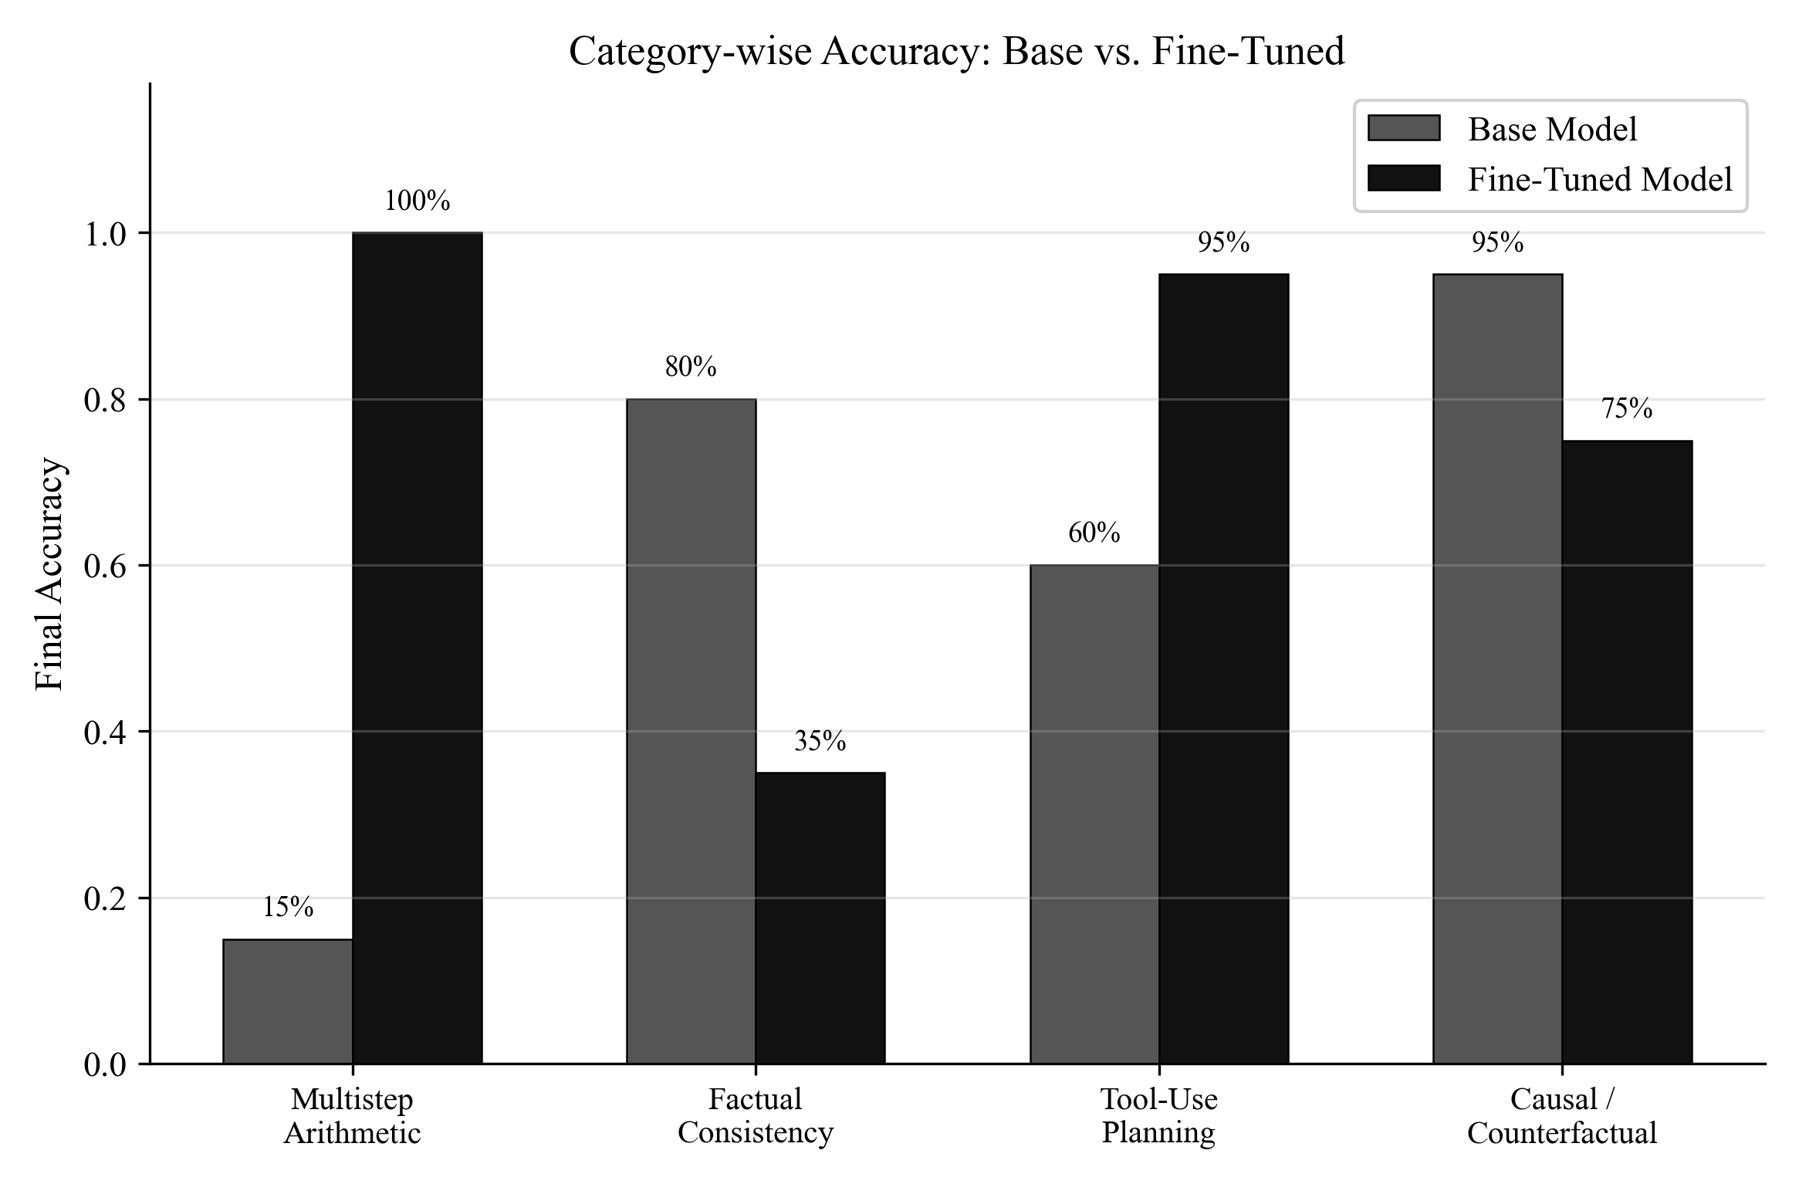
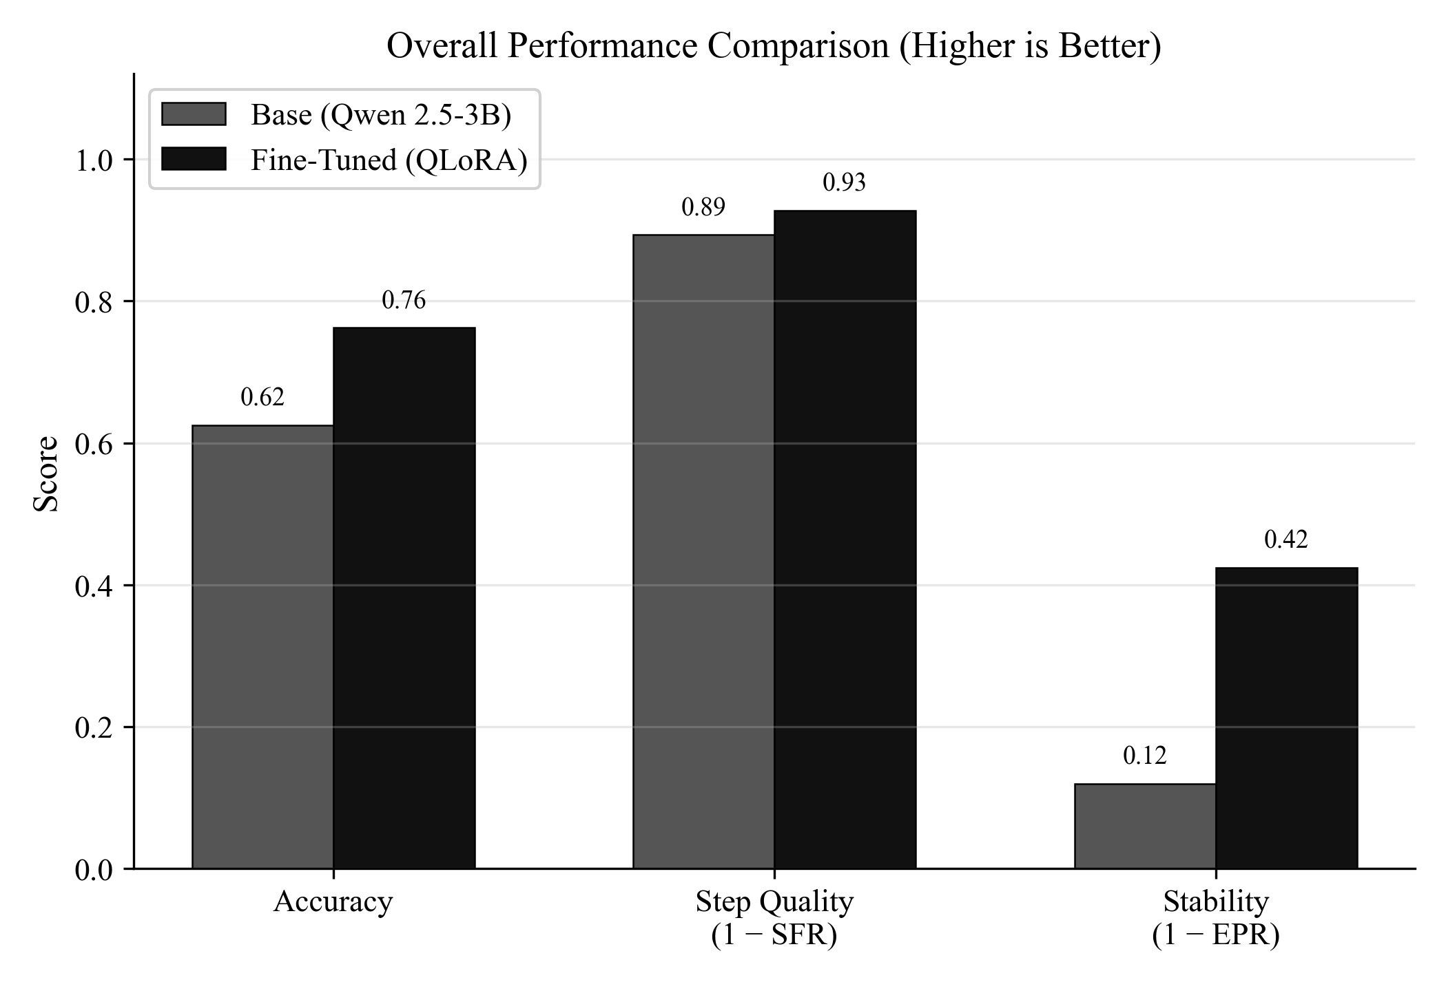
Results
Fig 1: Accuracy Comparison per Category
Fig 2: Overall Performance
LLM Reasoning Pipeline

Slide 13
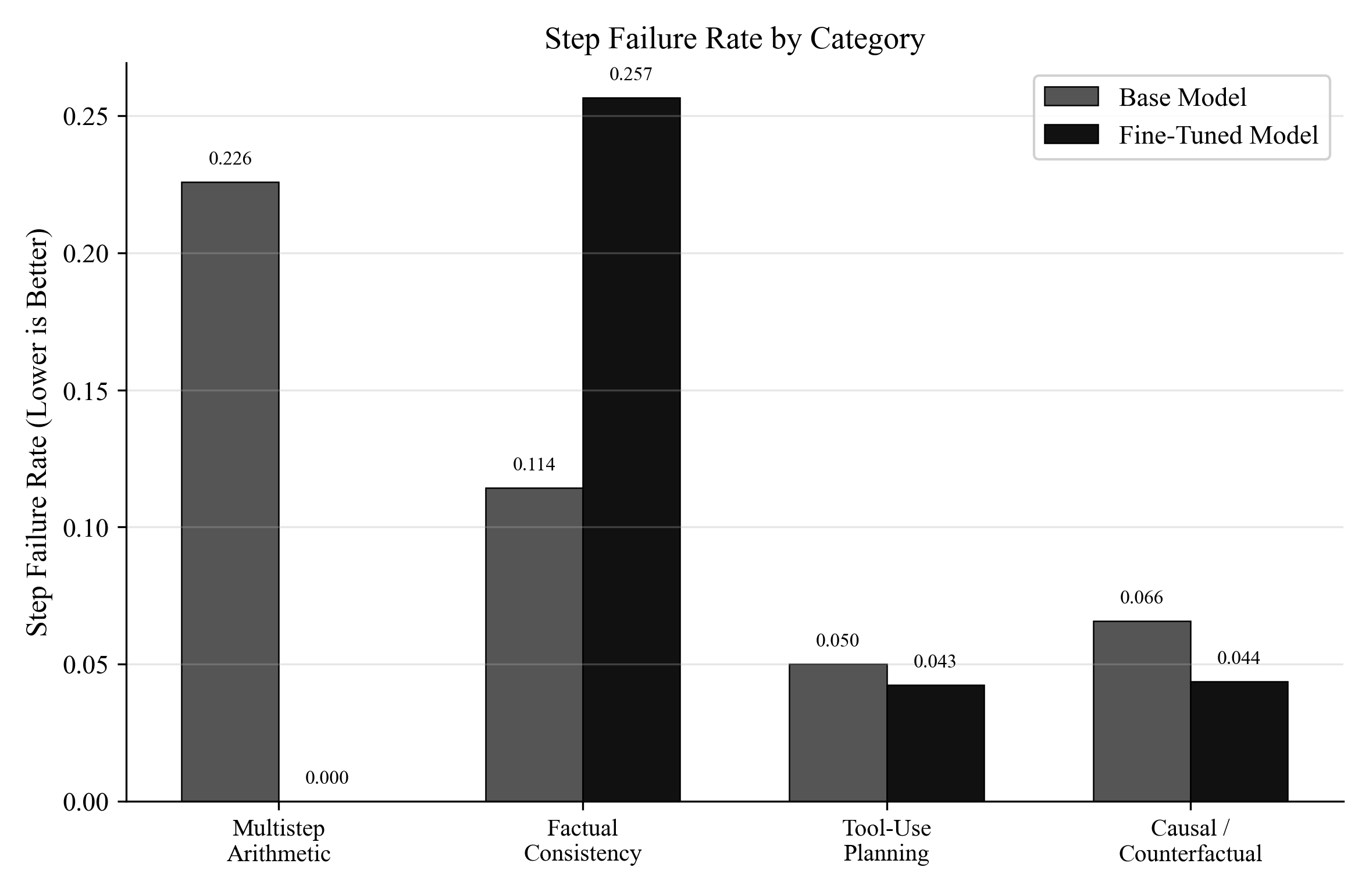
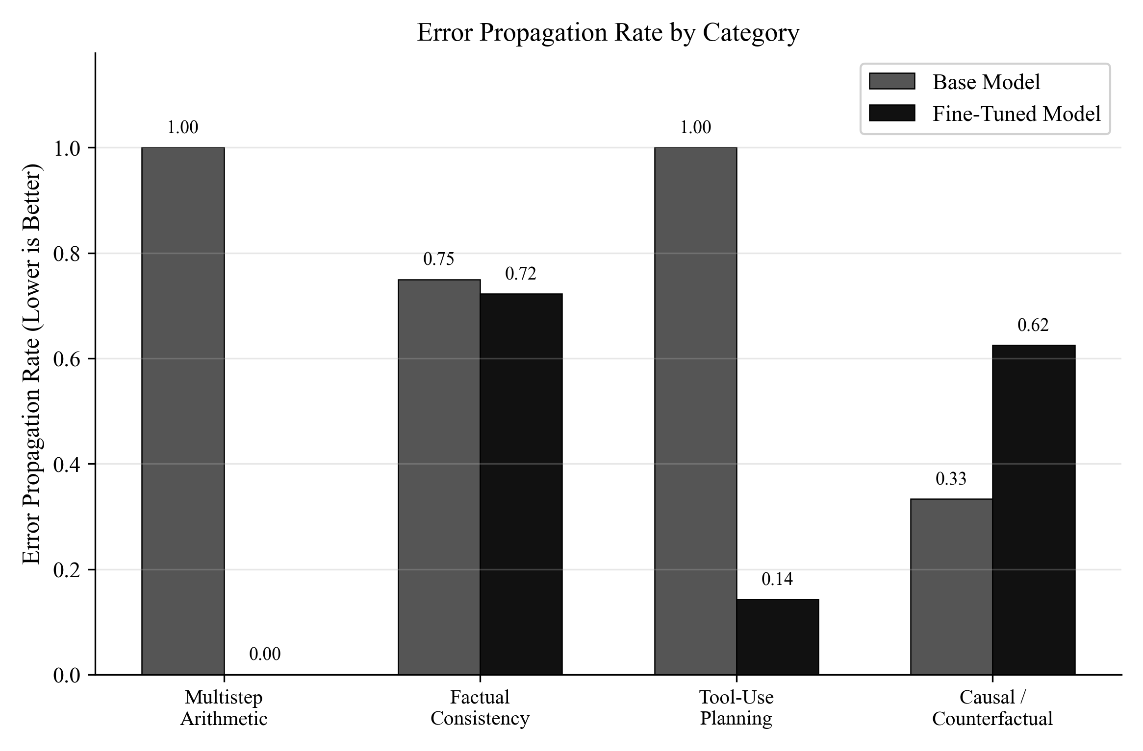
Results
Fig 3: Step Failure by Category
Fig 4: Error Propagation per Category
LLM Reasoning Pipeline

Slide 14
Case Study: Resolving Mathematical Logic Goal
Calculate the cost: $150 flat fee + $15/hr for 5 hours of work
🔴 Base Model (Failed due to Error Cascade):
Step 1: Records flat fee ($150) and hourly rate ($15).
Step 2: Adds them together first: $150 + 15 = 165$. [INVALID]
Step 3: Multiplies by 5: $165 \times 5 = 825$.
System Diagnosis: The target model violated mathematical order of operations, cascading into a drastically incorrect $825 answer.
🟢 LoRA Fine-Tuned Model (Success):
Step 1: Computes hourly total first: $15 \times 5 = 75$. [VALID]
Step 2: Adds flat fee: $150 + 75 = 225$. [VALID]
System Diagnosis: The Qwen-14B Judge confirmed the fine-tuned model successfully learned to isolate the multiplication step, yielding the correct $225 answer.
LLM Reasoning Pipeline

Slide 15
Case Study: API Dependency Sequencing Goal
Plan a workflow to summarize today's news about 'AI’.
🔴 Base Model (Causal Failure):
Step 1: Call summarize_text() to extract key points. [INVALID]
Step 2: Call search_news("AI") to fetch articles.
System Diagnosis: Fundamental sequential hallucination. The model attempts to summarize news before calling the API to retrieve it.
🟢 LoRA Fine-Tuned Model (Success):
Step 1: Call search_news("AI") to retrieve articles.
Step 2: Pass retrieved articles into summarize_text().
System Diagnosis: Targeted FP16 fine-tuning successfully imprinted strict causal dependencies into the SLM's logic matrix.
LLM Reasoning Pipeline

Slide 16
Conclusion
My research demonstrates that Step-Level Evaluation provides the critical visibility needed to transform AI from a “Black Box” into a verifiable reasoning engine.
By implementing a Teacher-Student diagnostic loop, we improved base accuracy from 62.5% to 76.25% on localized hardware while achieving a perfect 100% accuracy on the targeted Arithmetic category, and reducing step-level reasoning failures by 32.2%.
This validates that fine-tuned small models can securely and cost-efficiently fix logic flaws. Furthermore, future integration with higher-capacity models (7B-14B) will practically eliminate vulnerability to cross-category capabilities, allowing systems to scale new reasoning skills without severely forgetting factual knowledge.
LLM Reasoning Pipeline

Slide 17
Acknowledgement
I sincerely express my gratitude to all those who supported me during my internship as an AI/ML Virtual Internship at AICTE - EduSkills Cohort-14.
Prof. Dr. Mrs. S. A. Itkar, Head of the Computer Department, for her expert guidance.
Prof. Dr. Mrs. K. R. Joshi, Principal, for her leadership and vision.
Dr. B. D. Phulpagar, Mentor, for his valuable guidance.
I would also like to thank EduSkills for providing me with the opportunity to work in a professional environment and gain practical exposure in AI/ML.
This internship experience significantly enhanced my technical skills and helped me bridge the gap between theoretical knowledge and real-world application.
Yash Doke
LLM Reasoning Pipeline

Slide 18
References
Wei, J., et al. (2022). "Chain-of-Thought Prompting Elicits Reasoning in Large Language Models." NeurIPS 2022. arXiv:2201.11903
Cobbe, K., et al. (2021). "Training Verifiers to Solve Math Word Problems." GSM8K. arXiv:2110.14168
Lightman, H., et al. (2023). "Let's Verify Step by Step." OpenAI / ICLR 2024. arXiv:2305.20050
Hu, E.J., et al. (2021). "LoRA: Low-Rank Adaptation of Large Language Models." ICLR 2022. arXiv:2106.09685
Dettmers, T., et al. (2023). "QLoRA: Efficient Finetuning of Quantized Language Models." NeurIPS 2023. arXiv:2305.14314
Zheng, L., et al. (2023). "Judging LLM-as-a-Judge with MT-Bench and Chatbot Arena." NeurIPS 2023. arXiv:2306.05685
LLM Reasoning Pipeline

Slide 19
References
Frohberg, J. & Binder, F. (2022). "CRASS: A Novel Data Set and Benchmark for Causal Reasoning." LREC 2022. arXiv:2112.11941
Kadavath, S., et al. (2022). "Language Models (Mostly) Know What They Know." Anthropic. arXiv:2207.05221
Huang, J., et al. (2023). "A Survey on Hallucination in Large Language Models." ACM Computing Surveys. arXiv:2311.05232
Lewis, P., et al. (2020). "Retrieval-Augmented Generation for Knowledge-Intensive NLP Tasks." NeurIPS 2020. arXiv:2005.11401
LLM Reasoning Pipeline

Slide 20

LLM Reasoning Pipeline

